Slide 2
AMPT Center quick overview
Launched in August 2019 with Inaugural AMPT Symposium – over 20 companies represented
Leverages Rice’s core strengths in materials, additive manufacturing, and mechanics
Multidisciplinary capabilities: brings together faculty and research staff from five Rice Engineering departments (and growing)
Focused objective: uniquely integrated approach to design and optimization of materials and systems having components in relative motion
Industry centered: AMPT Center research agenda is driven by its industry members

Slide 3
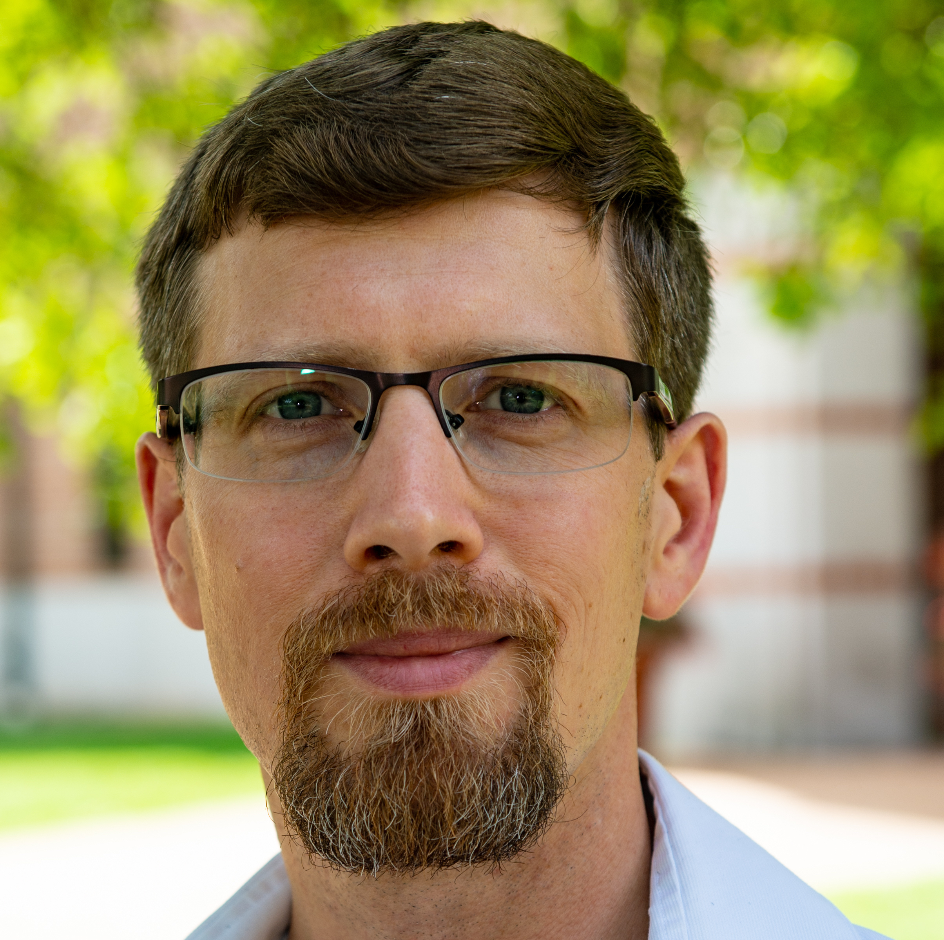
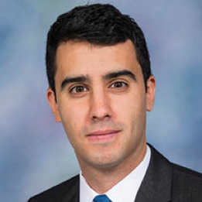
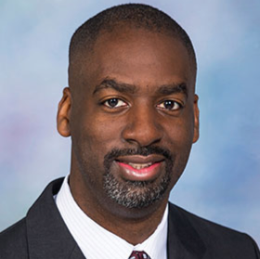
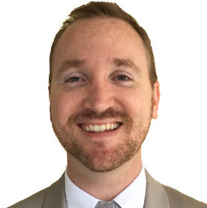
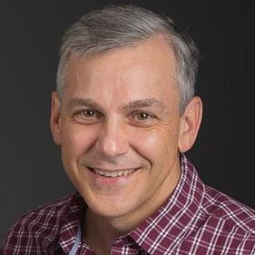
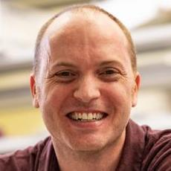
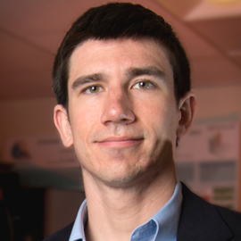
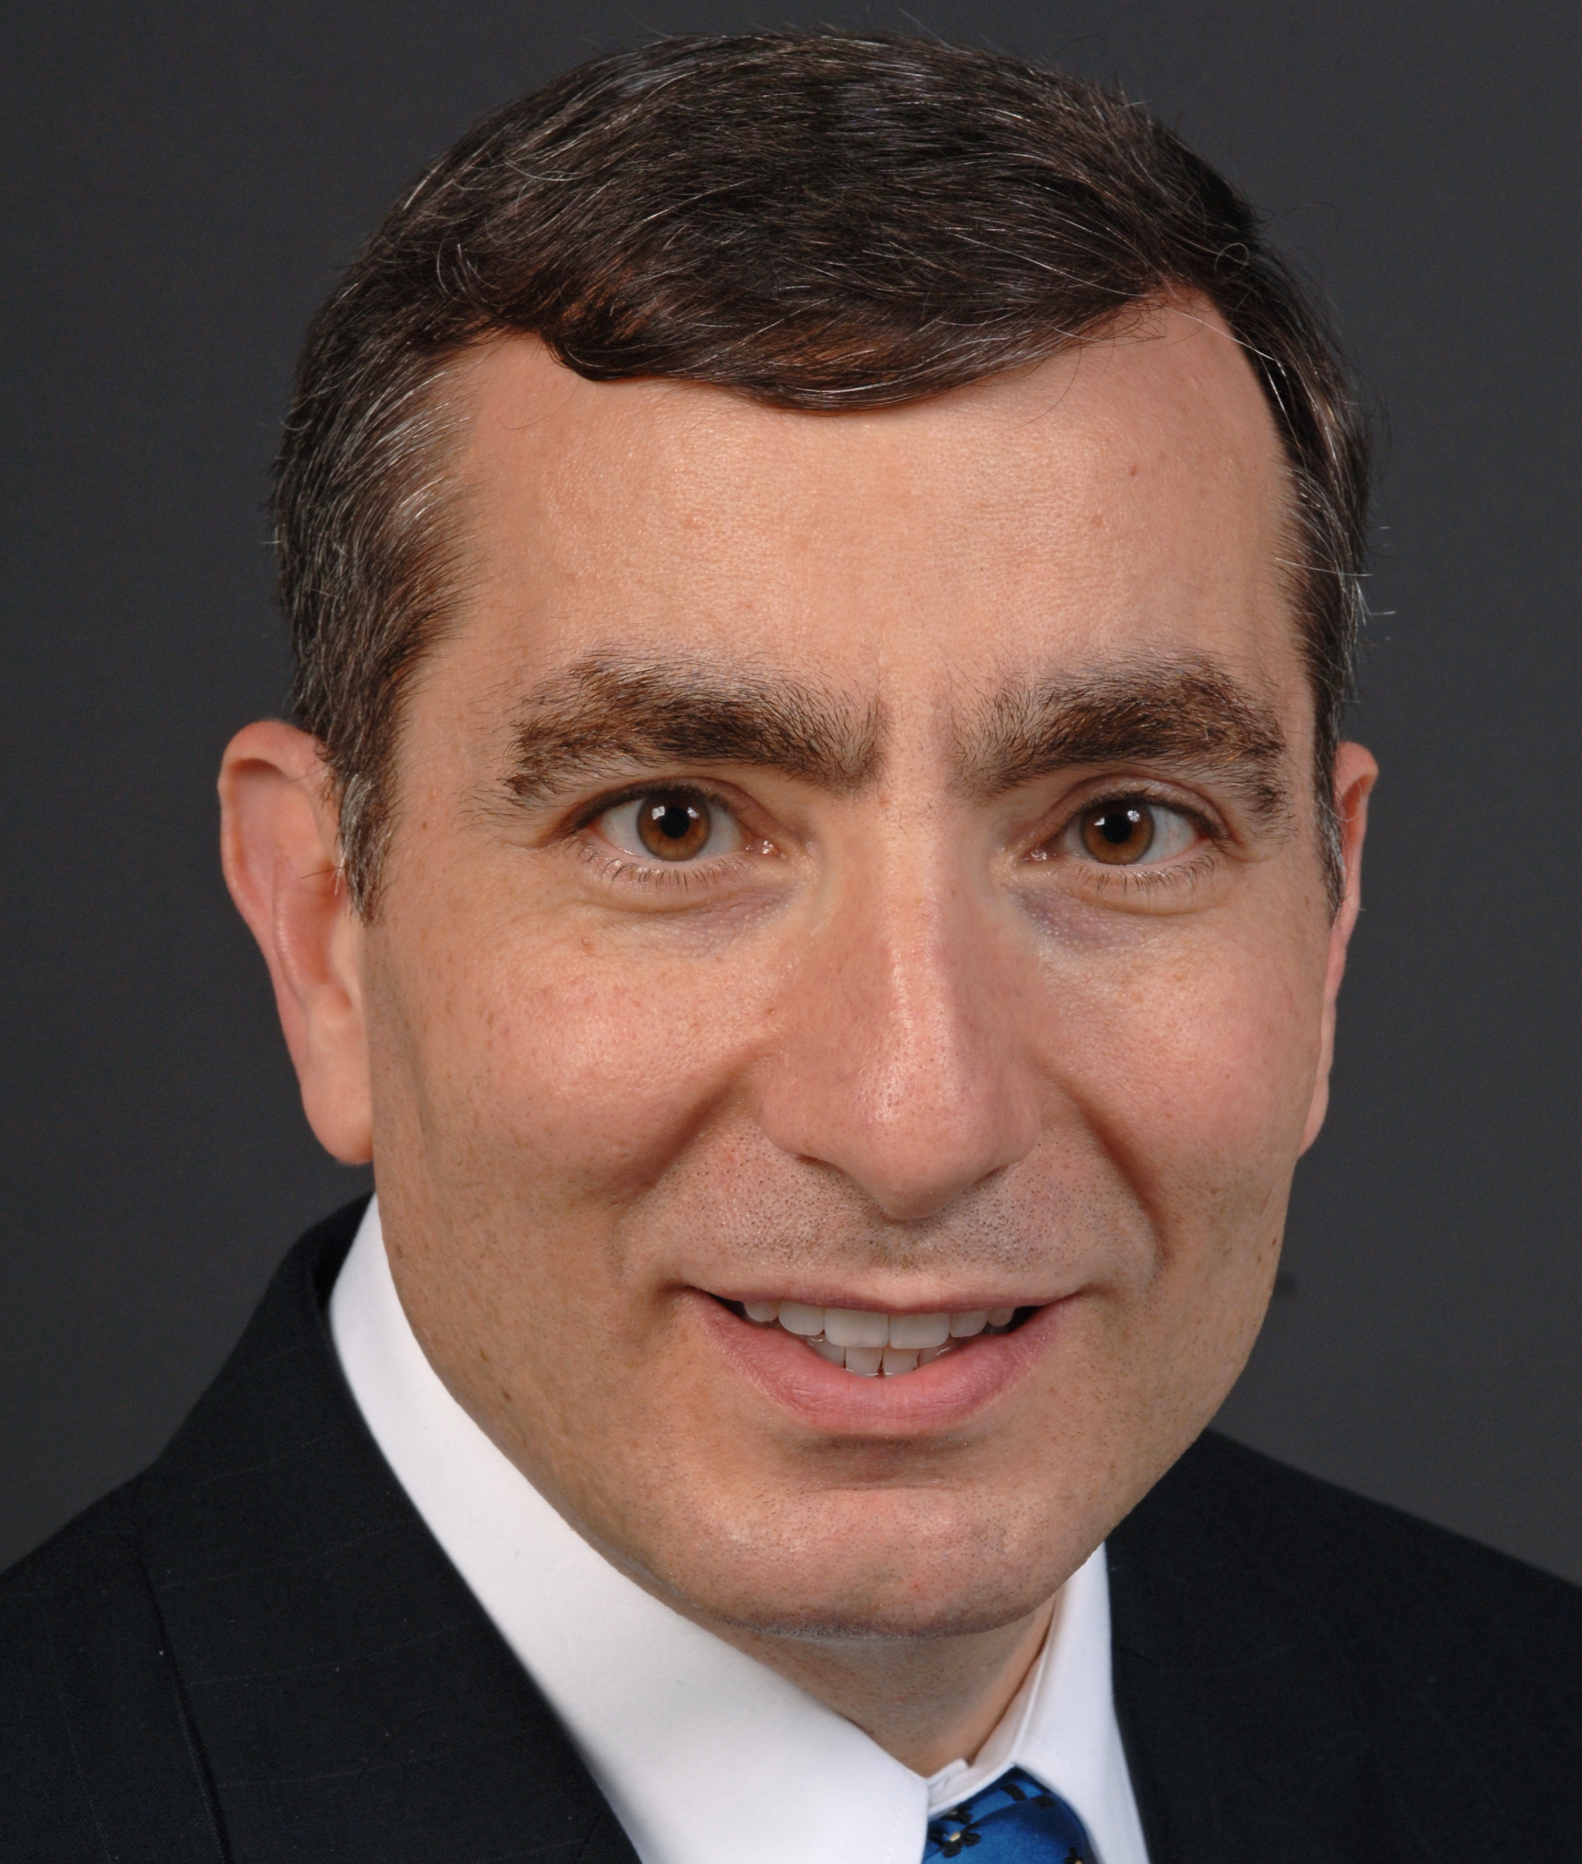
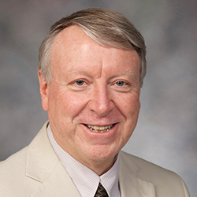
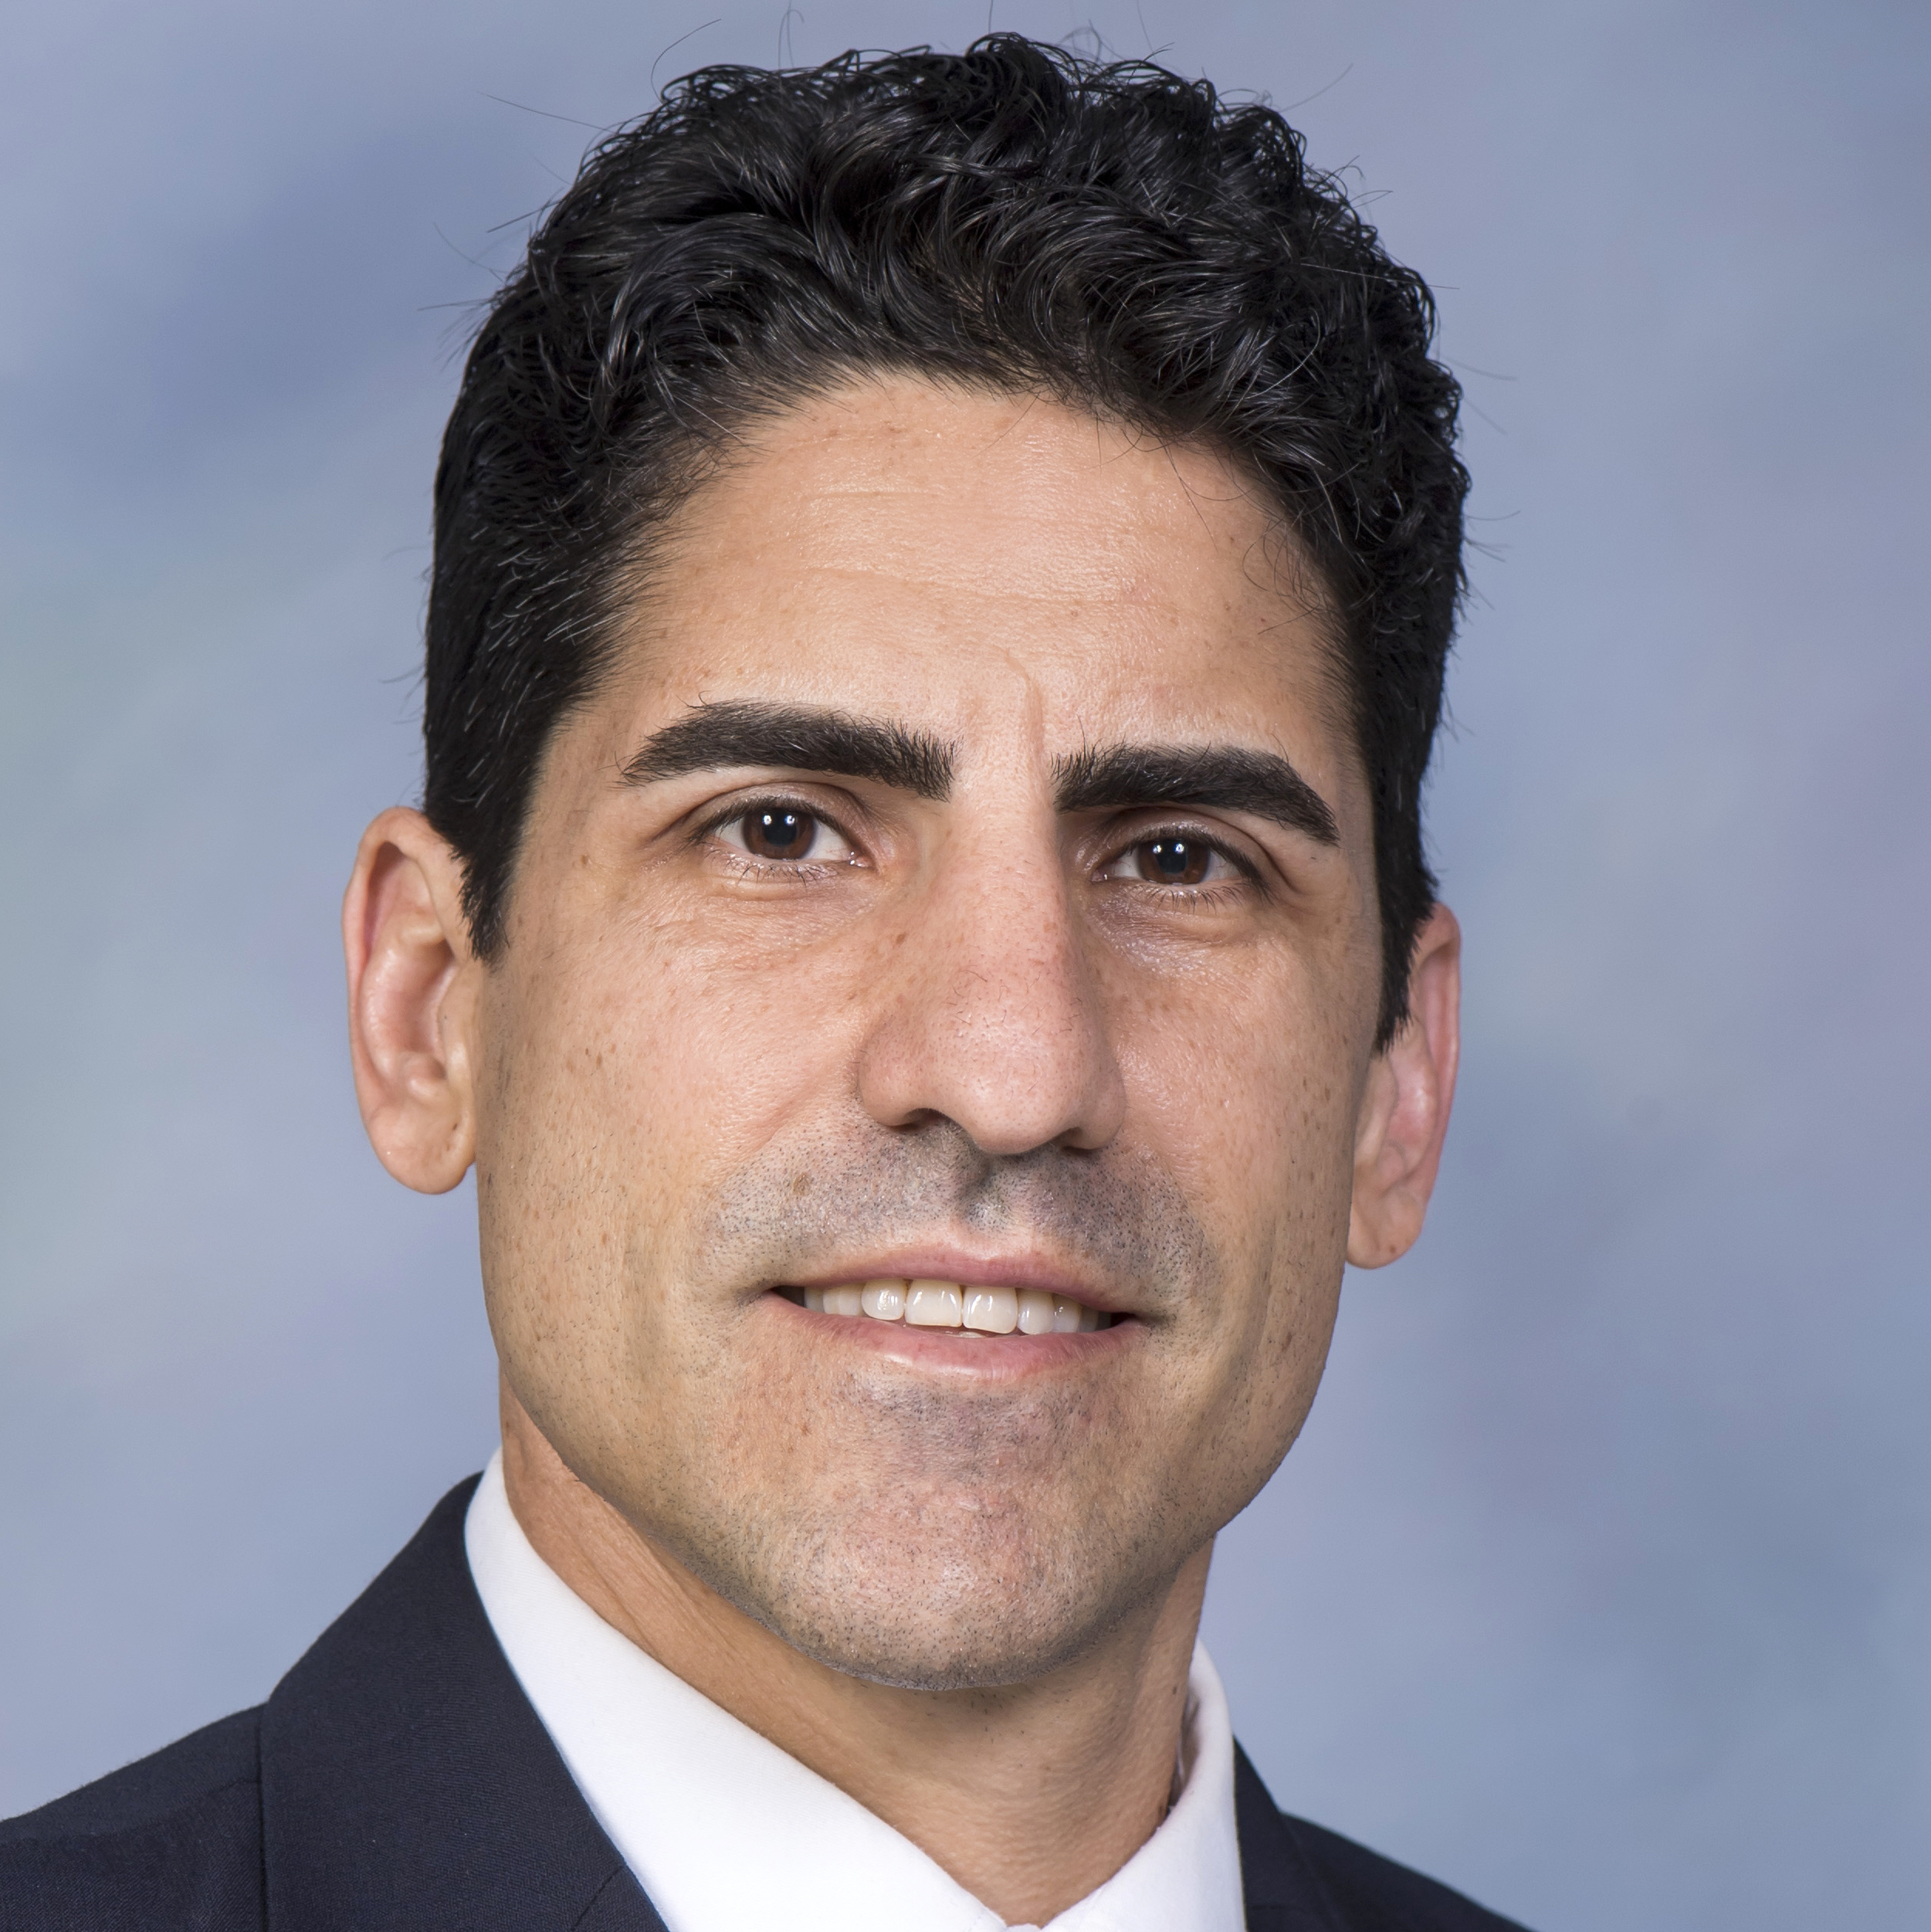
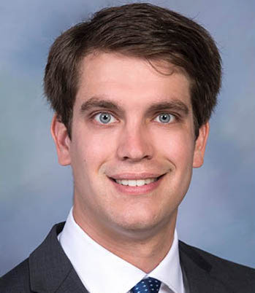
AMPT Faculty and Research Staff (partial roster)
Matthew Brake, FASME
Mechanical Engineering
Zack Cordero
Materials Science & NanoEngineering
Fred Higgs, FASME
Mechanical
Engineering
Prathamesh Desai
Mechanical
Engineering
Nicholas Dunbar
Mechanical Engineering
B.J. Fregly
Mechanical Engineering
Jordan Miller
Bioengineering
Daniel J. Preston
Mechanical
Engineering
James Tour, NAI, FAAAS
Chemistry /
Materials Science & NanoEngineering
Ned Thomas, NAE, AAAS
Materials Science & NanoEngineering
Rafael Verduzco
Chemical &
Biomolecular
Engineering
Geoff Wehmeyer
Mechanical
Engineering

Slide 4
Basics of AMPT Membership
Seat on AMPT Center Advisory Board
Participation in Annual Symposium
Access to Rice faculty and students
Short courses and training on AMPT instruments
Direction of research projects
Associate,
Standard &
Executive Members
Standard &
Executive

Slide 5
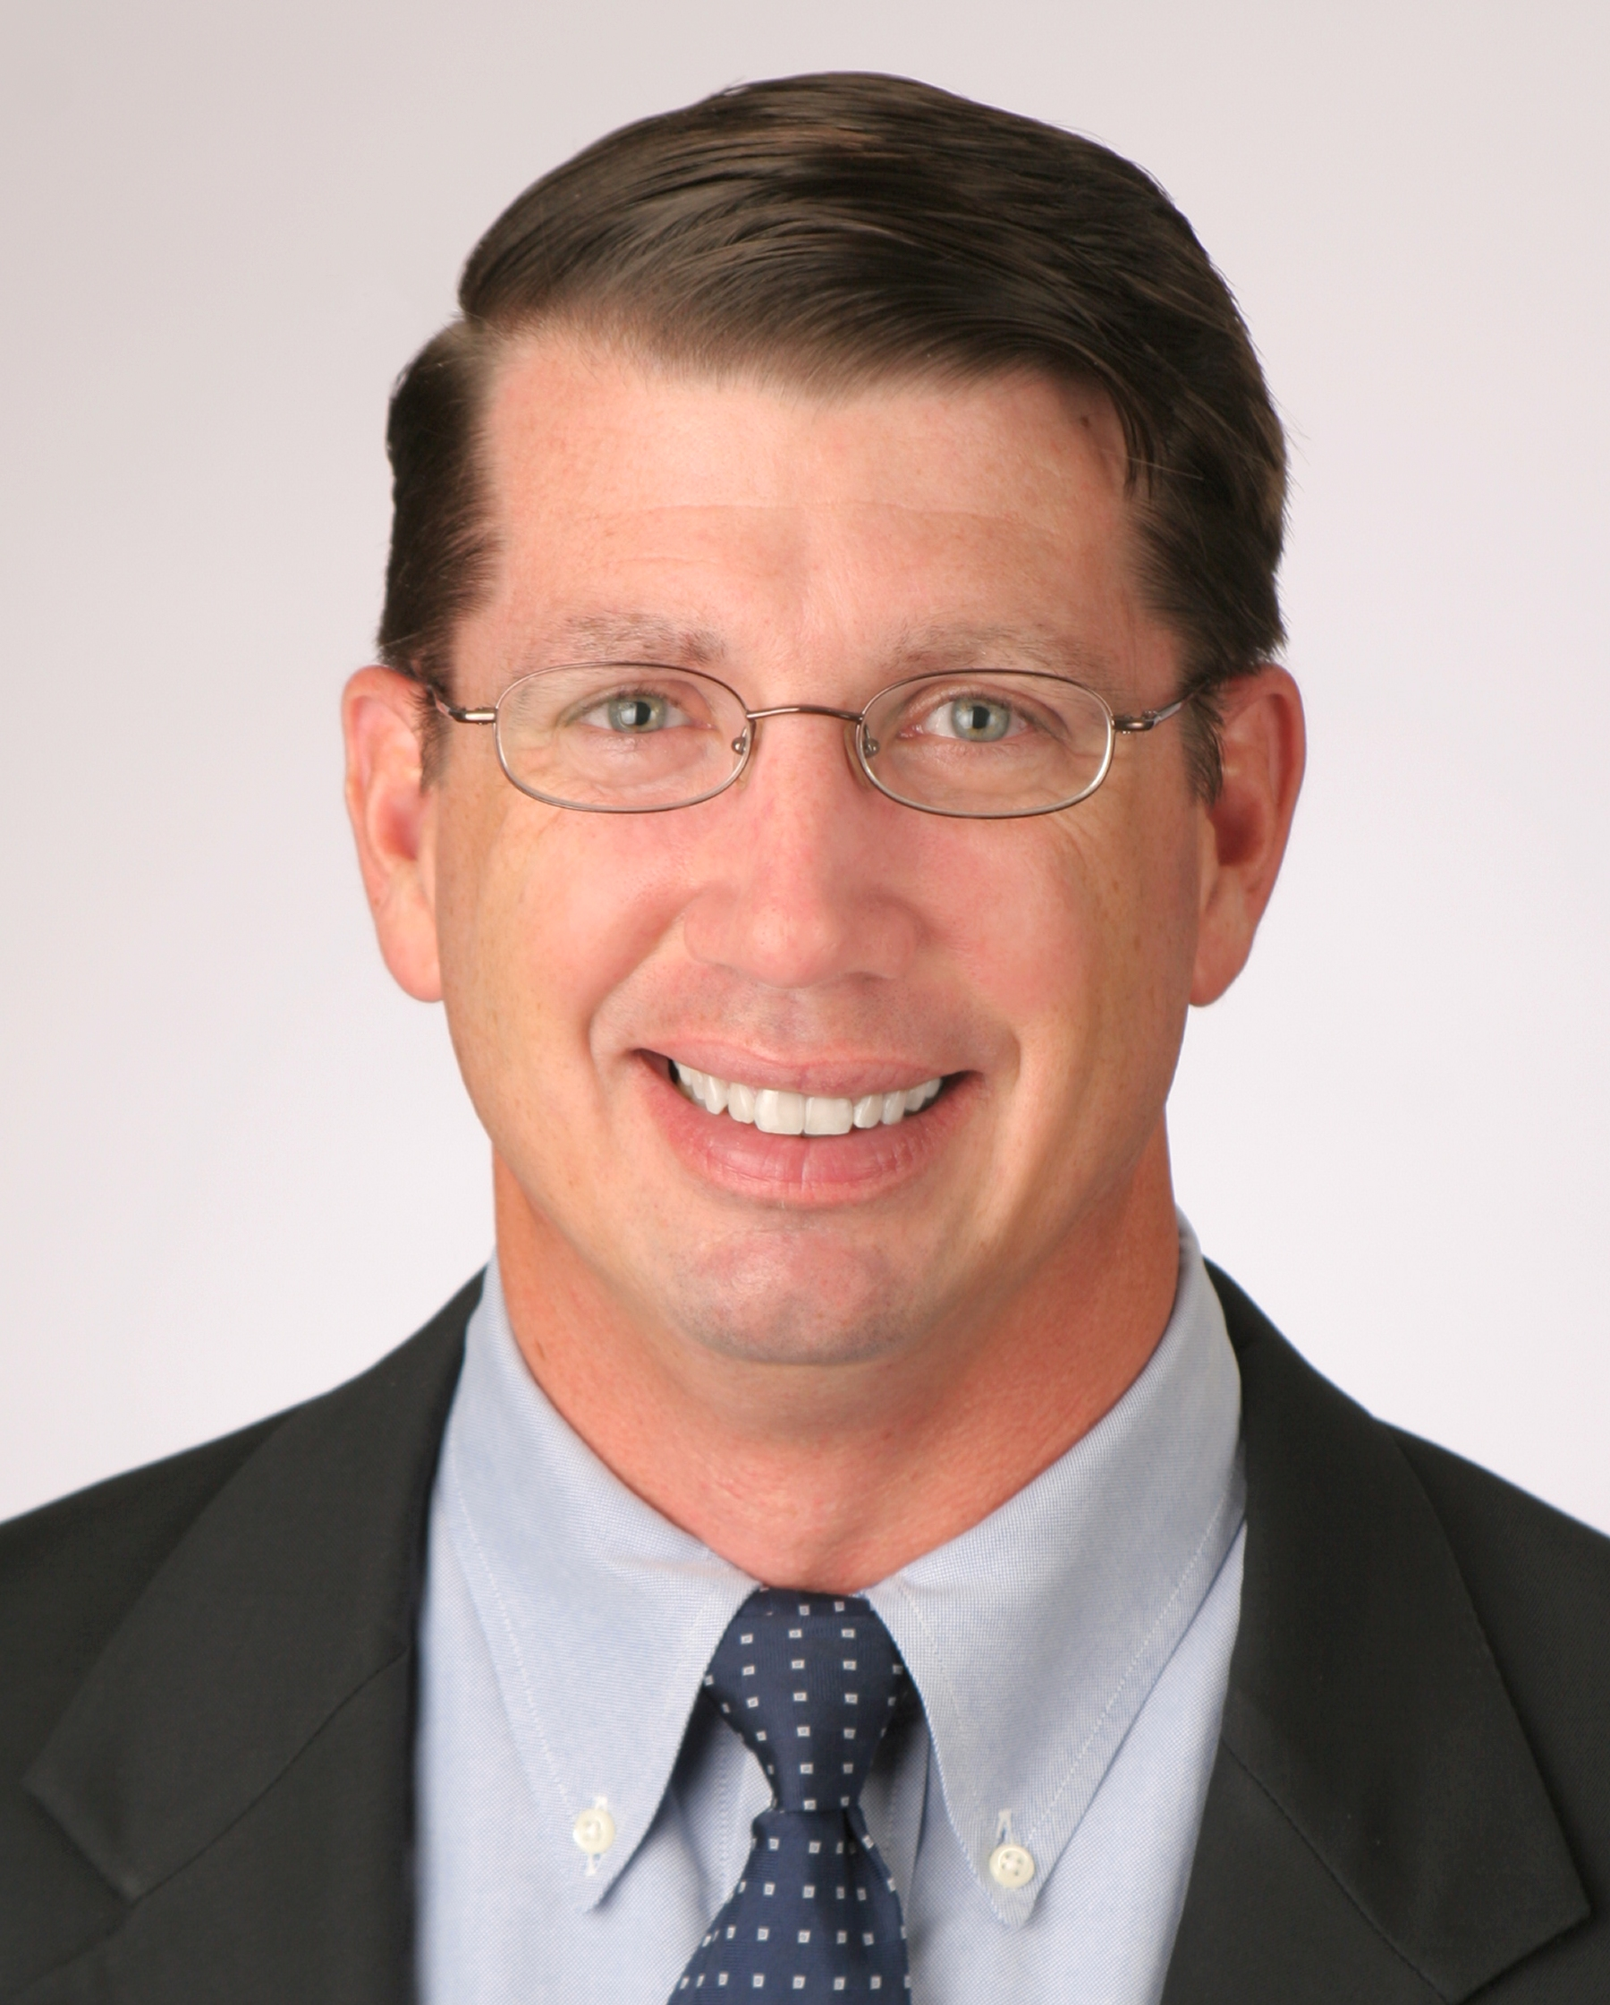
Questions?
George Webb, AMPT Center Industry Liaison
Rice University – MS 363 6100 Main Street, Houston, TX 77005
(713) 348-2704
gwebb@rice.edu

